Slide 1
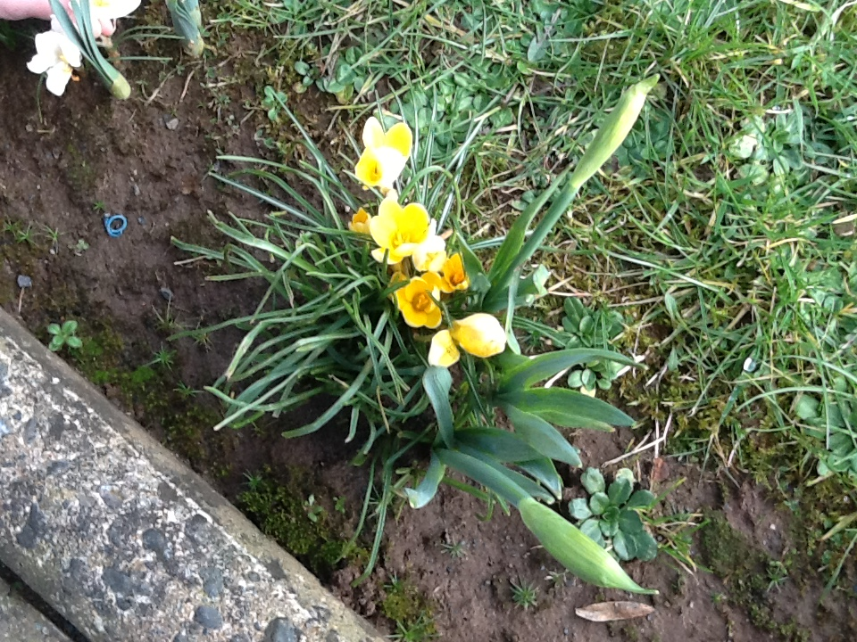
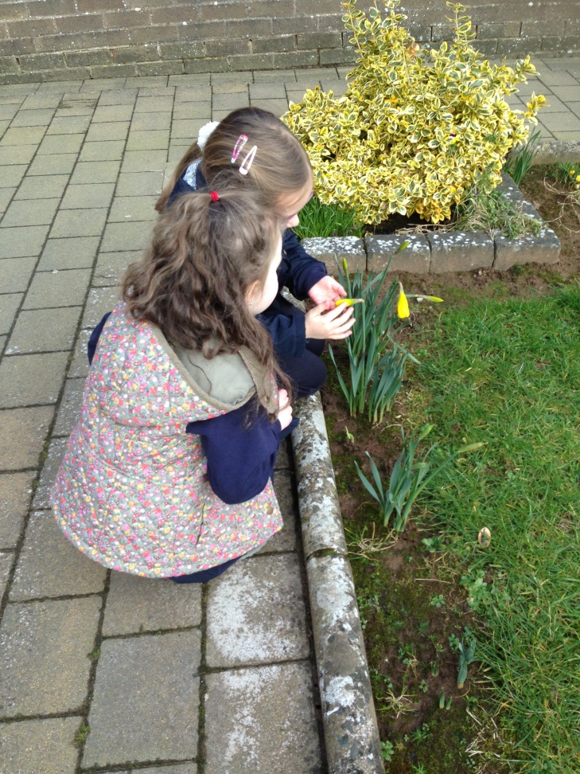
Our Spring Nature Walk

Slide 2
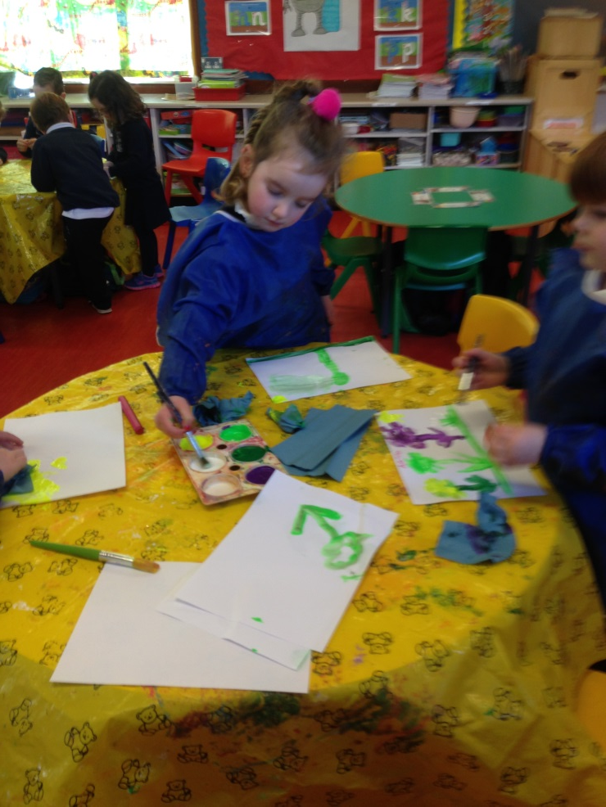
We recorded what we saw using paint.

Slide 3
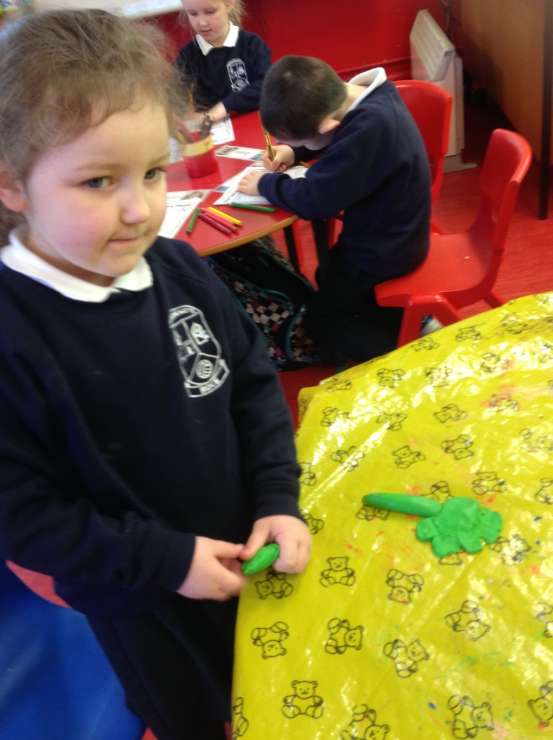
We recorded what we saw using playdough.

Slide 4
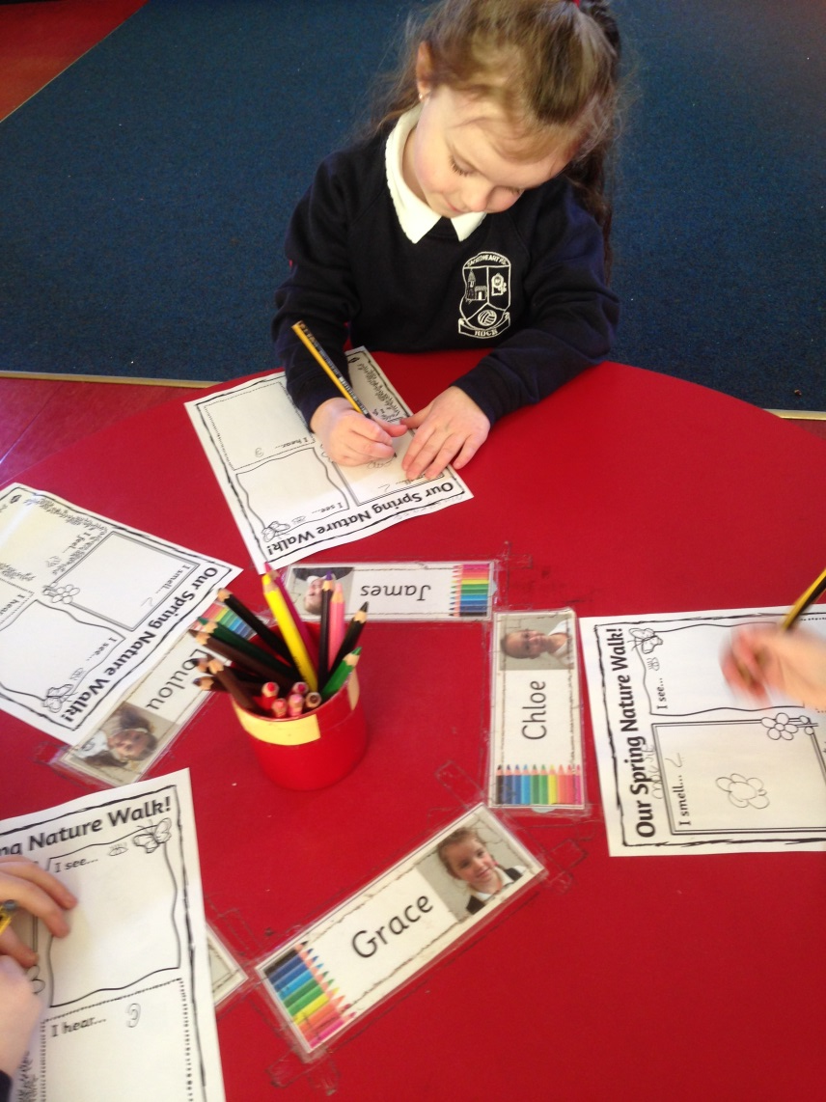
We recorded what we saw by drawing pictures.

